Slide 1

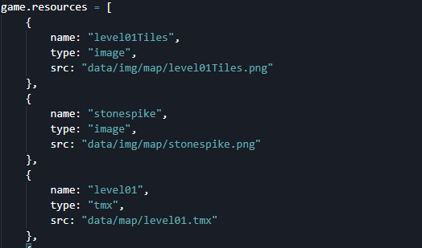
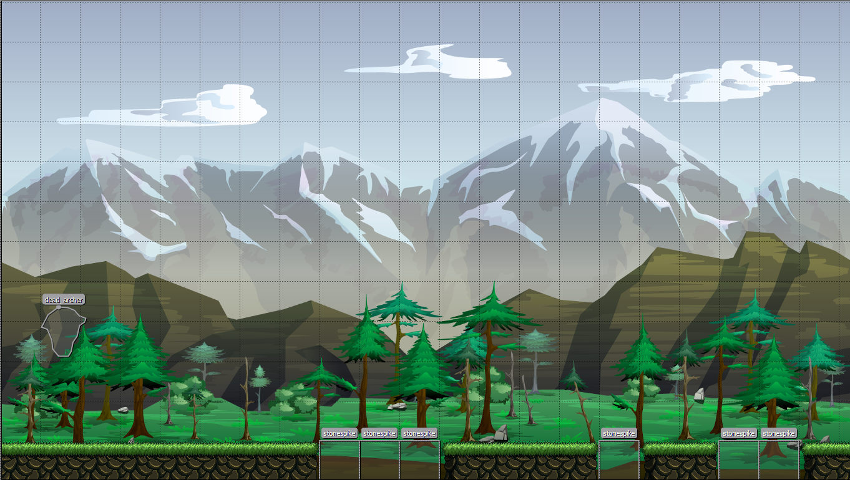
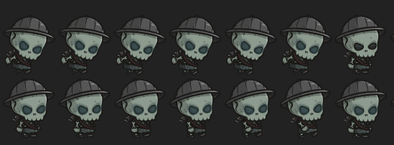

AutoRunner John Montes CIS 3830 - Project
Abstract
Building games has multiple functions, from artistic design to good flow of logic behind characters and assets. The field of game development can be a challenging and stressful work environment, but the end result is also rewarding. Out of all the game genres that exist today, platformer style games are among the most known styles that are still being developed to this day. With the increased use of web technologies, new and improved game engines are being built, making it easier for people to create their own games, with little to no coding experience necessary.
Statement of the Problem
Building a 2D style platformer game requires the use of multiple tools for building the layout levels, animating characters, and defining the functions necessary for a game to load properly onto the web. Using the Tiled Map Editor I was able to easily create a level for my character, but defining how objects would behave when colliding together was the difficult part. Another issue with the game was me not being able to properly define the gravitational force on the main character. If one continuously keeps pressing the space button, then the character will never stop jumping and eventually land outside of the viewport. Lastly, I decided to implement multiple backgrounds into the game, each scrolling at different rates in order to create a sense of depth to the game. Although I was able to create a parallax effect, most of the backgrounds would only render once touching the center of the viewport.
Theoretical Justification
In order to get the game running, I first called the me.game classes from MelonJS in order for the game to have a play screen and a loss screen. From there I created a resources.js file where I bound all the game assets, backgrounds, and tiled maps that I built for the game. Once I found the asset I wanted to use for the game, I used TexturePacker to create a spritesheet. This way the game will consume less memory by having one spritesheet image than 30 separate images used to animate the character. Using MelonJS API, I can create animations by calling each sprite as and index list, depending on the current state of the character (jumping, standing, running, etc). After testing the logic for the character entity, I added stones that would act as mines if the player were to accidentally step on them. The main reason to this was because I was not able to find a way to reset the seen of the character were to fall off the map. Once the character touches the stone mine, it changes the screen title, triggering the functions for the loss screen. But players can cheat if they continuously press the space bar, making the character fly into space, outside of the viewport.
Recommendations
If one chooses to develop with a specific game engine, then its necessary to allocate enough time to read through the API documentation in order to properly define functions for game objects. Learn how to render animations and/or backgrounds outside of the viewport, especially for scrolling games like this one, so that screen ripping does not occur. This will also give the game a more seamless feel and make it more enjoyable. Using a game engine with a built-in map editor can help reduce the amount of time needed for development. Working with separate software (Tiled editor, MelonJS API) adds time in development since that requires reading the documentation for two separate programs/APIs and creates higher chances of breaking a game due to incompatibilities between both.
References
Understanding MelonJS API: http://melonjs.github.io/melonJS/docs/index.html Building Spritesheets with TexturePacker: https://www.codeandweb.com/texturepacker Creating Levels using Tiled: https://www.mapeditor.org/

